Slide 1
Annual Title 1 Spring Meeting
April 24, 2020
By: Mr. Olaizola

Slide 2
Agenda
HISD Updates due to COVID-19
State Assessments
Virtual Learning -Class Dojo
Academic Expectations
Online Student Registration
Wraparound Updates
Questions & Comments

Slide 3
HISD Updates
The building is close for the remainder of the 2019-2020 school year.
HISD will continue to mail out paper-based assignments.
Continue Practicing Social Distancing – Do not visit the Tijerina Playground
Summer School information has not been finalized. We will keep you posted
For the latest updates, please visit:
https://www.houstonisd.org/HealthAlerts

Slide 4
State Assessments
Will HISD extend the Texas English Language Proficiency Assessment System (TELPAS) and TELPAS Alternate administration window this school year? (Updated as of 4/21/20)
Per Governor Abbott’s April 17, 2020 order, school classrooms will remain closed for the remainder of the 2019-2020 school year therefore, HISD will not complete the 2020 TELPAS and TELPAS Alternate assessment.
What assessments have been cancelled for this school year? (Updated as of 04/21/2020)
Academic assessment requirements are suspended for the remainder of the 2019–2020 school year. This includes all STAAR assessments including tests for grades 3-8, End-of-Course (EOC) Assessments, and STAAR Alternate 2 tests.
All remaining spring district assessments have been canceled for the 2019-2020 school year.

Slide 5
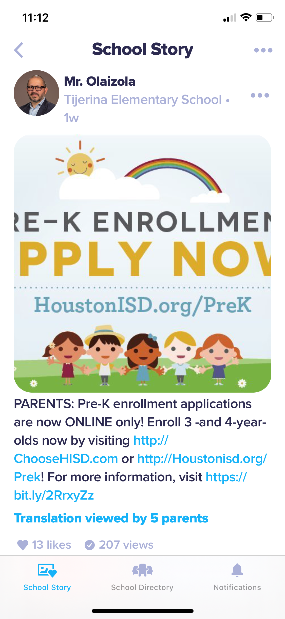
Virtual Learning Class Dojo
Thank you to all parents who have created a Class Dojo account and have encouraged students to view lessons and submit assignments.
Class Dojo can be used on any device: cell phone, Ipad, and computer
Teachers will be posting videos, assign work, and conduct live lessons.
Zoom – A few teachers will conduct live lessons on zoom. Your child will receive a link to join the lesson.
Don’t forget to watch the Weekly Updates by Tijerina Admin on Class Dojo.

Slide 6
Academic Expectations
Virtual Learning (Online Learning)
Watch video uploaded videos and join live lessons.
Complete all work assigned by classroom teacher.
Log into Class Dojo multiple times a week.
Reach out to your teacher for assistance.
Paper-bases Instruction
Complete the all the work mailed out by the teacher
Reach out to your child’s teacher for assistance.

Slide 7
PreK Registration
Pre-K enrollment applications are now ONLINE only! Enroll 3 -and 4-year-olds now by visiting http://ChooseHISD.com or http://Houstonisd.org/Prek! For more information, visit https://bit.ly/2RrxyZz
If you have any questions, please contact any of the Tijerina administration team or inform your child teacher.

Slide 8
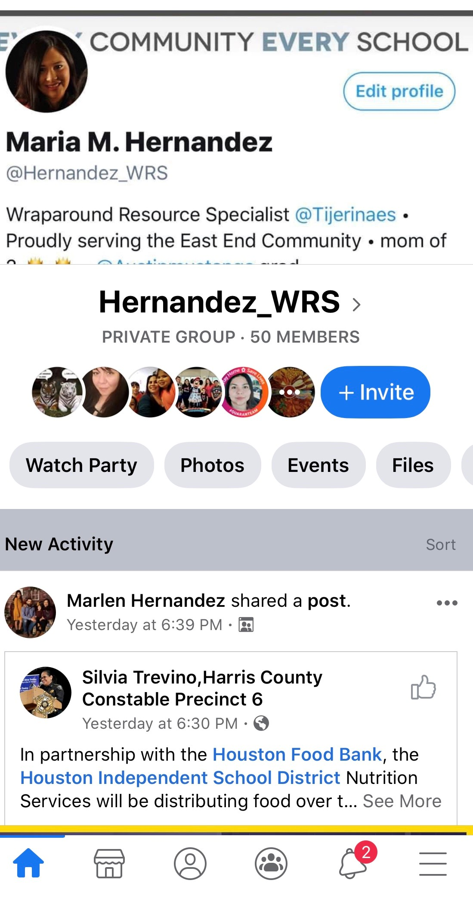
Wraparound Updates
Please follow Ms. Hernandez on Facebook: Hernandez_WRS
Christian Community Services Adoption
Immaculate Conception Food Pantry Every Saturday from 8am – 10am
April Food Fairs: April 30th RIPLEY HOUSE (4410 Navigation, Houston, TX, 77011)
Next FACE Parent Meeting with Mr. Meza will cover HISD@HOME
Spanish Meeting – miercoles, 29 de abril @ 2pm
English Meeting – Thursday, April 30th @ 2pm

Slide 9
Census 2020

Slide 10
SFSP

Slide 11
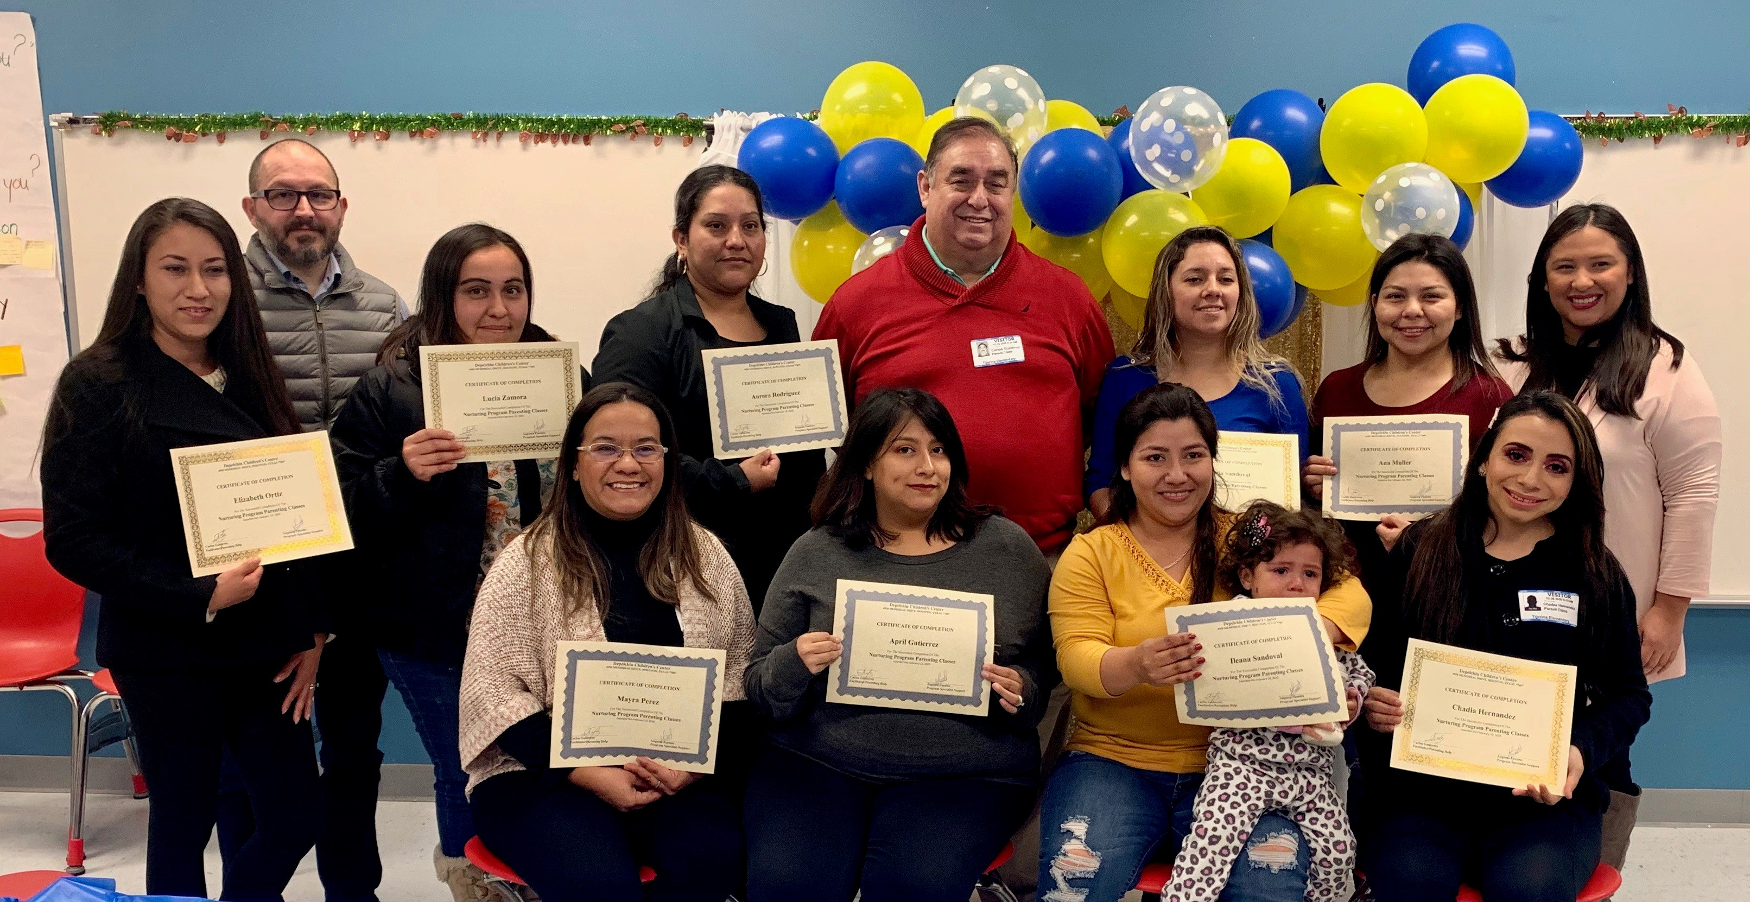
Thank You Tijerina Volunteers
“Volunteers do not necessarily have the time; they just have the heart”
“Los voluntarios no necesariamente tienen el tiempo; simplemente tienen el corazón"

Slide 12
Questions? Comments? Concerns?
Preguntas?
Comentarios? Preocupaciones?

Slide 13
Thank you! Gracias!

